Slide 1
Emerging architectures for GenAI applications and the corresponding organization

Slide 2
Understanding GenAI archetype use cases

Slide 3
Envisioned scenario shapes the application architecture
Complexity and organization maturity
Scenario
1
2
3
4
5
NLU & PLU applications
(Within the token limits)
Dynamic external knowledge required
Model adaptation required
Interaction with the business environment. Reasoning, planning actions required
Interaction of different parts of a business process is required
Business Examples
Entity resolution ; Sentiment analysis; Completion; Email routing ; summarization; structured data extraction
Code completion; Functional business rules extraction from code; Business rules classification; Business rules standardization (e.g. SBVR)
Internal Question-answering systems.
Customer Facing Conversational AI systems
Knowledge base construction
Recommender systems
Sound more like a medical professional,
Write in a specific style, or
Use the jargon of a specific industry (Real Estate, Banking, etc.)
Integrate an LLM agent in a supply chain management system to analyze data and make predictions about demand and inventory needs.
Include an LLM agent in a financial trading platform to analyze market trends and provide investment recommendations.
Automation of a complex business or IT process.
LLMs off the shelf
Prompt Engineering
Chaining
RAG systems built around LLMs
Finetuning
Prompt engineering
Chaining
RAG
Agents
Plugins
RAG
Agents
Plugins
Multi-Agents system
Architectural Design

Slide 4
Life Cycle of a GenAI power app
Update app
Interact with the GenAI powered App
Satisfying outcomes
Align with
the dev team
Analyse feedback
Prioritise new ideas
Evaluate & Feedback
Playground & experimentation
Novice User, analysts, developers
.
Develop, deploy and monitor GenAI powered apps
AI/software Engineers
.
Decision
Business Users
Experiment different GenAI Models
Release app
Develop app
Orchestration, Configuration, Caching, Logging, Evaluate & Validation LLM
Try new ideas
(Few-shots) Prompting, Advanced Prompting
Build & Package
Test the app
Make decision
Business
IT
Business

Slide 5
Strategies for Scaling Enterprise-Wide GenAI Deployment

Slide 6
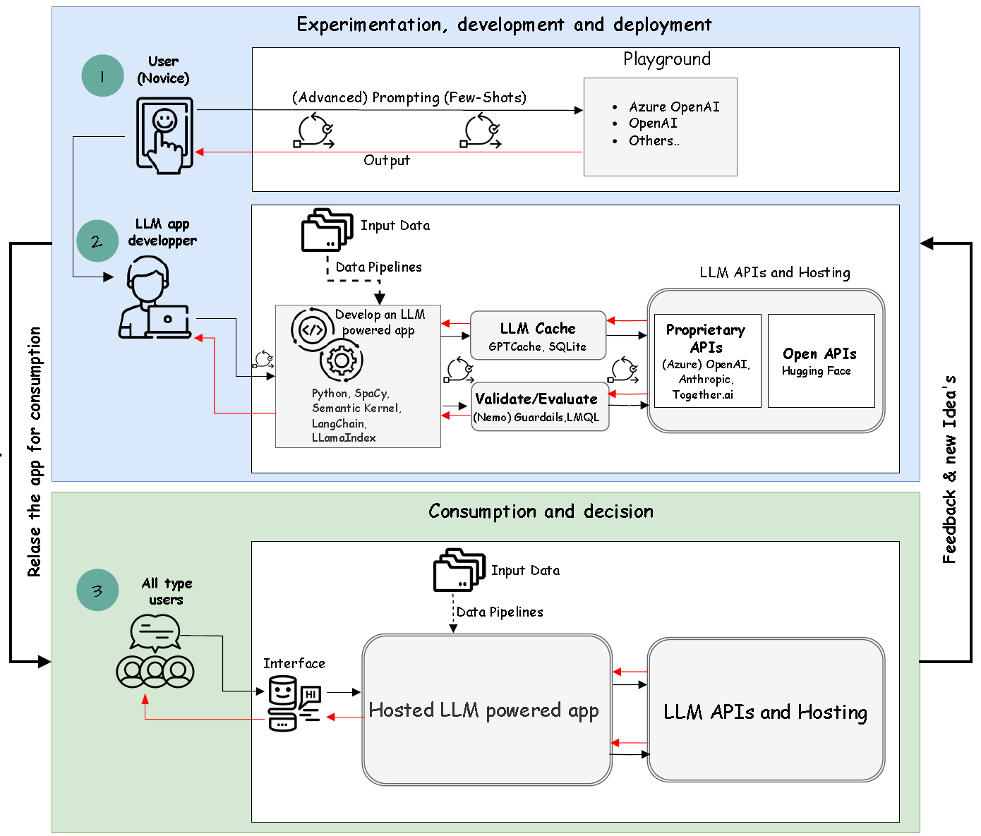
An example scenario of using Off-the-Shelf LLM: data and metadata management
As a user in the role of a data manager, I want an enterprise-ready GenAI(ChatGPT) that enables my team and I to interact with and analyze our data and metadata content. Once satisfied with the results, I wish to have the capability to apply the same process at scale to different datasets and multiple metadata sources stored in different containers.
Scenario

Slide 7


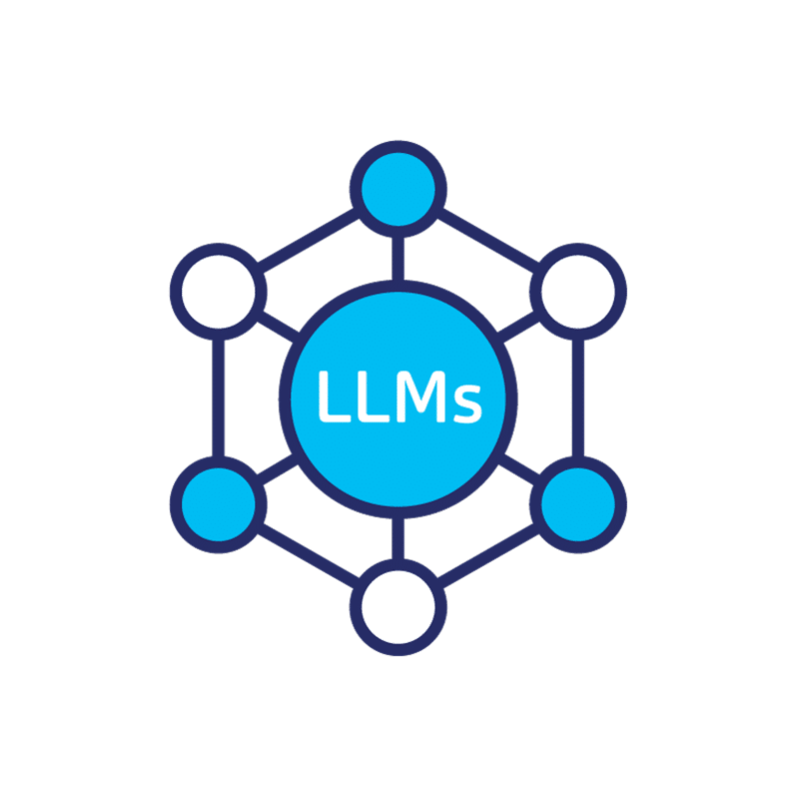

Making Enterprise-Ready GenAI/ChatGPT for data and metadata content exploration
Activity 1
Deploy an enterprise-ready GenAI/Azure OpenAI service for discovery and experimentation
Container Image
Azure Container Registry
Azure Web app
Web app
Guardrails
Prompt Customization
Azure OpenAI API
Other LLMs Endpoints

Slide 8

Making Enterprise-Ready GenAI/ChatGPT for data and metadata content analysis
Activity 2
I wish to have the capability to apply the same process to multiple datasets and metadata sources. Add the data storage to the flow
Container Image
Azure Container Registry
Azure Web app
Data Source
Web app
Guardrails
Prompt Customization
Azure OpenAI API
Other LLMs Endpoints

Slide 9
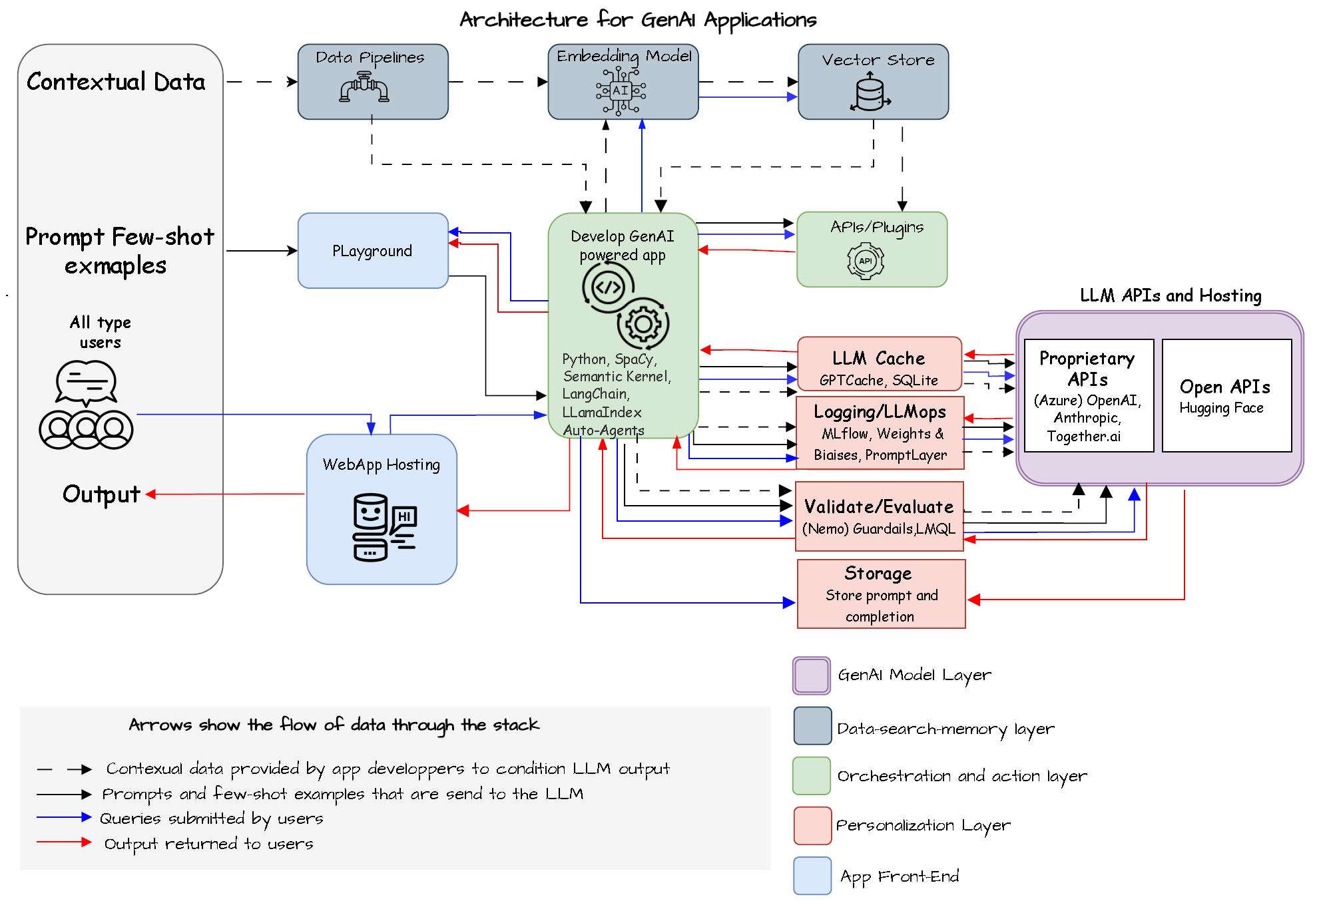
Dynamic knowledge base required: Retrieval Augmented Generation System
Objective 2
As a dataManager, I need a solution that allows me to analyze multiple datasets their multiple metadata stores in parallel, So that I can efficiently compare information, even when dealing with large context beyond GenAI’s context capabilities.

Slide 10
WHAT THIS IS ABOUT
We aim to establish a robust, secure, and scalable architectural blueprint that caters to various Generative AI use scenarios, from individual users to development teams.
WHY THIS IS IMPORTANT
Generative AI is rapidly becoming an essential tool. Enterprise deployment of GenAI, however, requires a well-thought-out, secure, scalable, cost-effective, and safe architectural framework.
WHAT THE GOALS ARE
Enable everyone to utilize Generative AI technology seamlessly.
Create standardized, secure, cost-aware architectural blueprints.
WHAT THE RISKS ARE
Failing to equip users with necessary technology may result in user frustration due to complex tools and processes, subsequently leading to decreased adoption or shadow GenAI.
A Central team, tasked with delivery, could potentially become a bottleneck, impeding progress.
The emergence of unauthorized Generative AI technologies not adhering to company policies could pose significant legal and financial risks.
……………………………………….
Technology & Architecture
Empowering every employee with a secure, innovative copilot to boots productivity

Slide 11




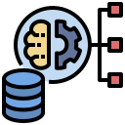



Key concepts: Building a future-proof scalable, secure, and cost-effective architectural blueprint for GenAI deployment
KEY CONCEPTS EXPLAINED
The incorporation of GenAI across businesses necessitates an adaptive architecture that strikes a balance between enablement and control.
The enablement aspect is user-focused, aiming to equip users with an own GenAI co-pilot, not only those provided by microsft It involves making appropriate models accessible for varied tasks and understanding the data consumption of these models while ensuring data availability. The goal is to seamlessly orchestrate these activities.
On the other hand, control is crucial for a secure, scalable, and cost-efficient adoption of GenAI. It encompasses monitoring of GenAI usage, identifying unusual patterns, and executing rate-limiting mechanisms to maintain system security and prevent misuse.
A federated architecture is integral to the democratization of GenAI. It provides individual users with the appropriate tools while preserving central control, thus fostering responsible and effective AI usage and ensuring the ethical application of GenAI at an enterprise level.
Balancing enablement and control is a key element of an adaptive technology and architecture strategy for GenAI, crucial for its democratization within enterprises.
Design Principles
Future-Proof: Design an architecture that easily adapts to advancements in Generative AI models, considering the models, the data- search-memory , reasoning and action and personalization layers. It should allow for easy integration of new tools and updates.
User-Centric Design: The architecture should cater to different user types, including front-line workers, explorers, experts, and innovators.
Versatility: The architecture should accommodate different GenAI use cases such as RAG, fine-tuning, autonomous multi-agents, etc.
Enterprise Alignment: Ensure the architecture aligns with the overall enterprise architecture, including the technology and data principles, standards, and guidelines.
Cost-Effective and Transparent: Design the architecture to be cost-effective with clear visibility of the cost implications associated with different technologies and services.
Robust Infrastructure: This encompasses security, scalability, performance, sustainability, and compliance. The architecture should incorporate robust security protocols, be designed with scalability and high performance in mind, and comply with relevant regulations and standards.
CONSIDERATIONS FOR IMPLEMENTING GEN-AI IN ENTEPRISE: USER-SPECIFIC TECHNOLOGY CAPABILITIES & ENTERPRISE-LEVEL MANAGEMENT
USER-SPECIFIC TECHNOLOGY LAYER
ENTERPRISE-LEVEL TECHNOLOGY AND ARCHITECTURE MANAGEMENT
PERSONALIZATION LAYER
involves giving the language model a personality and developing a relationship with the user. This involves tracking user’s prompt and customizing the output via prompts, customized prompts, guardrails implementation, and eventually fine tuning the GenAI model.
COST MANAGEMENT AND GRANULAR CHARGEBACK
Because every business unit will be asking you for AI. You should adopt a strategy and solution solution to handle throttling limits and eventually to chargeback.
ENTEPRISE RESPONSIBLE AI
Adopt GenAI guardrails to mitigate risk and potential damage to an organization's brand, operations, and customers, and comply with the Enterprise-wide Responsible AI principles
ORCHESTRATION AND ACTION LAYER
involves decision-making and actions. It could involve equipping GenAI model with planners, tools, APIs and memory for decision-making, or using reasoning engines.
DATA-SEARCH-MEMORY LAYER
The Search/Memory/Data layer involves getting information and injecting it into prompts. This includes considerations like semantic search, vector stores, accessing data, and the chosen language model's impact.
SCALABILITY AND REUSABILITY
Define (OpenAI) instance and models strategy
Define embedding strategy (avoid data deduplication)
Model calls caching strategy (save costs and speed up responses)
MODEL LAYER
The Model relates to the model used, such as OpenAI's GPT-4, GPT 3.5 or open-source models. Key considerations include model capabilities and model management
SECURITY
Security controls (virtual networks, private endpoints, DNS, Managed identities and RBAC.
Monitor usage; implement rate-limiting mechanism
Log any unusual usage to avoid attacks

Slide 12
WHAT THIS IS ABOUT
Creating a structure to integrate GenAI effectively, fostering innovative, data & AI culture.
WHY THIS IS IMPORTANT
A clear organization structure is key for GenAI adoption, promoting role clarity and collaboration. It aligns with our AI-focused goals, avoiding redundant efforts company-wide.
WHAT THE GOALS ARE
Establish an agile structure that supports GenAI and aligns with our goals. Foster cross-functional collaboration for GenAI innovation. Clarify everyone's role in GenAI implementation.
WHAT THE RISKS ARE
A vague structure can cause confusion and slow GenAI progress. Overlooking existing Data & AI systems may cause resistance and hinder GenAI integration, resulting in missed opportunities. Centralization may become a bottleneck for the widespread of the technology. ……
……………………………………….
Organization Structure
Aligning Structure with Strategy for Optimal AI Integration

Slide 13







Key concepts: Create an organizational structure to integrate GenAI securely, effectively, fostering innovative and data & AI culture.
KEY CONCEPTS EXPLAINED
The advent of GenAI, particularly in the form of chatGPT, is revolutionizing the way we work, as demonstrated by the "Statistics of ChatGPT" report. The potential for every employee and team to have an AI co-pilot assisting in efficiently and quickly accomplishing tasks is becoming a reality.
However, enabling all employees to leverage this technology is a complex task. It involves catering to diverse needs, from those requiring a simple, secure, and straightforward chatbot to those needing a more intricate architectural setup to fulfill their roles.
The organization's structure plays a pivotal role in this enablement process. A well-considered organizational structure is crucial to ensure the secure, safe, and cost-effective use of this technology. It also aids in identifying roles and responsibilities, which can be a challenging task given the widespread demand for this technology.
An effective organization helps clarify two key areas: enablement and value delivery. Enablement involves setting up the systems, processes, and training that allow employees to use AI tools effectively. Meanwhile, value delivery focuses on how the use of AI translates into tangible benefits for the organization, whether that's in terms of efficiency, cost savings, or other metrics
Design Principles
Enterprise Integration: GenAI will be integrated across the business. The structure should promote widespread adoption, enabling all employees to utilize this technology.
User-Centric: Cater to the diverse needs of users securely and safely. Understand and meet unique requirements, ensuring proper management of ROI when introducing GenAI.
Standardization: Create and adhere to standards and blueprints for delivering value with GenAI. This ensures consistency and efficiency across the organization.
Agility: Facilitate quick experimentation and deployment of GenAI applications. Adopt a federated model to foster innovation in the business unit while maintaining control centrally.
Governance and security: Prioritize security, safety, and governance in the use of GenAI. Establish clear guidelines, conduct regular reviews, and handle any arising issues robustly.
ROI-Focused: Support effective management of GenAI's ROI. Regularly track and evaluate its business impact, adjusting strategies to maximize returns.
Collaboration and communication: Promote open communication and collaboration among teams working with GenAI. This drives collective progress and knowledge sharing.
NURTURE A CENTRE OF EXCELLENCE WITH A MODEL THAT FIT BEST YOUR ORGANIZATION
Phase I:
In this phase, the CoE aims to:
Establish a dedicated team with a defined mission, vision, and objectives.
Build scalable GenAI capabilities through a diverse use case portfolio.
Highlight the value of GenAI through successful use case deployment.
Monitor feedback and validate GenAI safety and security.
GenAI CoE, Enabling
Phase 2/3:
In this phase the CoE:
Will transit into an enabling role, with the organization assigning delivery teams to serve various business units, backed by the CoE.
Will continue to build capabilities and produce blueprints for new use case types, such as the development of plugins and autonomous agents. This will be done through delivery of limited new type use cases
Will adopt new practices, techniques, models, and technologies within the GenAI industry.
Current practices will be refined through field monitoring.
Business Unit
(HR, Finance, Customer Service)
Business Unit
(HR, Finance, Customer Service)
IT delivery Team
Enables
Delivers
Delivers
Delivers
Business Unit
(HR, Finance, Customer Service)
Delivers
Enables
Enables
Enables
GenAI CoE, Enabling
Enables
Enables
Prepare for technical demands with scalable architecture, Azure GenAI models/ OpenAI instances, storage strategies, and role access permissions to accommodate current and future users.
Ensure readiness in terms of procedures, organization, governance structure, and skills to transition the CoE from a delivery entity to an enabler entity for phase 2.
Delivers
Enables
Enables
Delivers

Slide 14
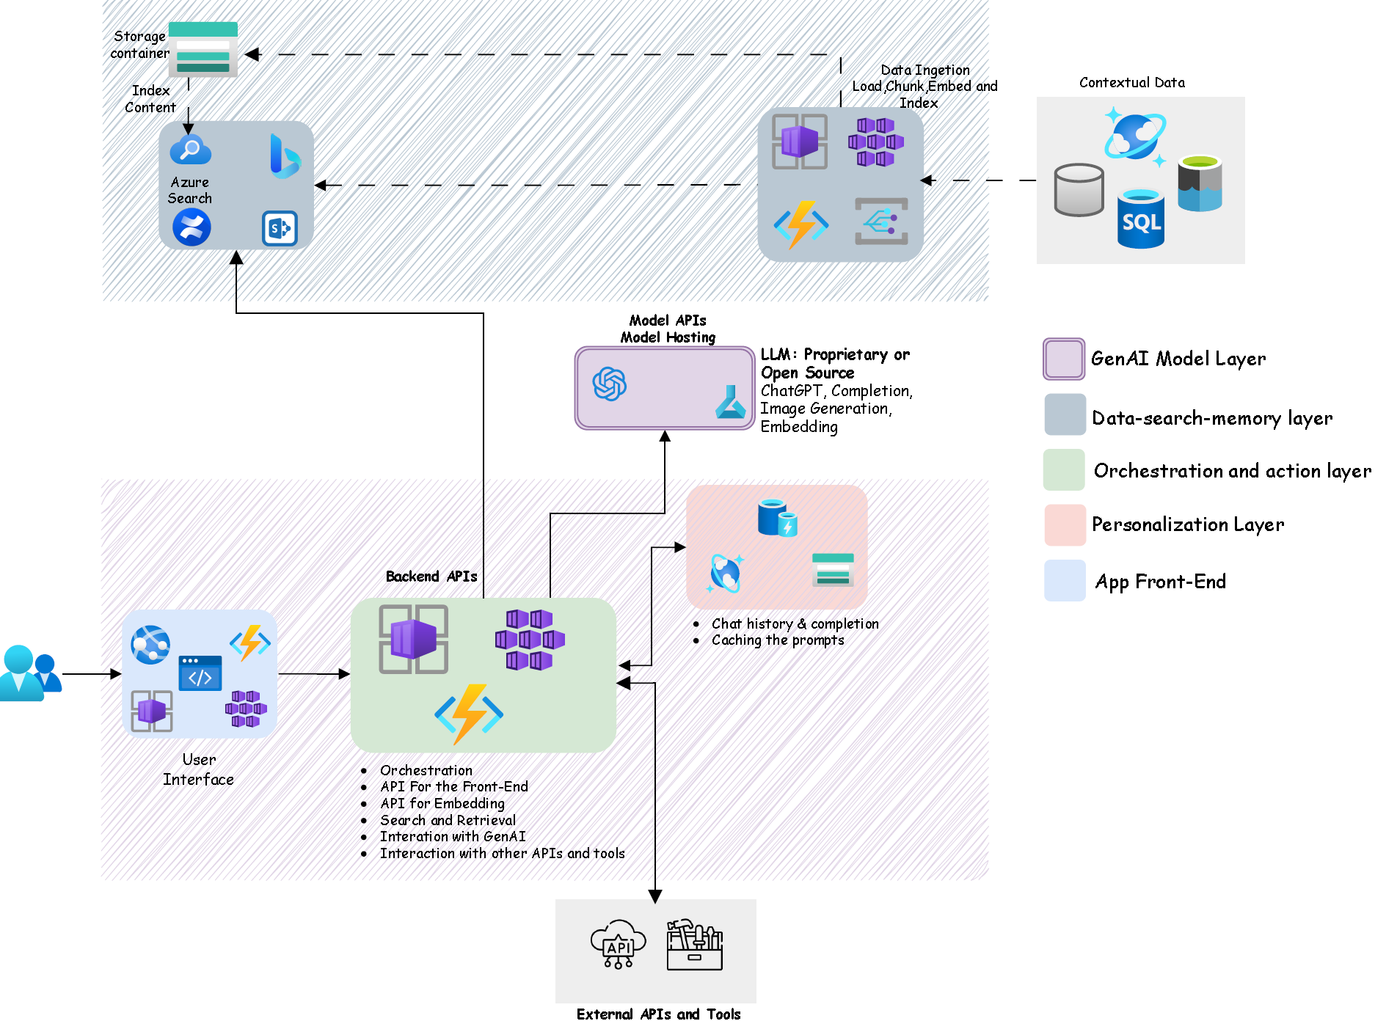
User-specific technology layer: Azure Solution

Slide 15
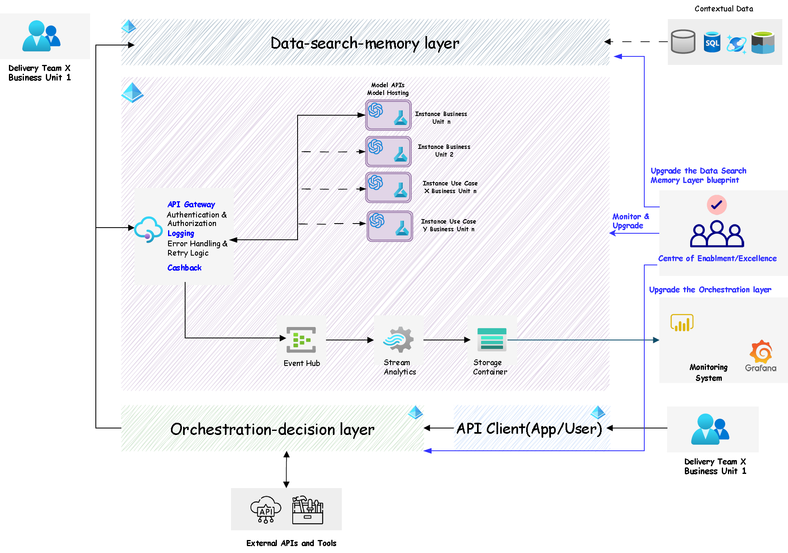

Enterprise-level technology and architecture management

Slide 16
Deciding between building your own Azure solution or using Microsoft’s prebuilt solutions
Complexity and organization maturity
KEY CONCEPTS EXPLAINED
Deciding between using Microsoft’s pre-built solutions or building your own Azure solution largely depends on your organization's specific needs, resources, and technical capabilities.
If your needs align with the functionalities provided by out-of-the-box solutions like Github Copilot or Microsoft 365 Copilot, these are efficient and cost-effective options. These pre-built solutions require minimal setup and are ready to use, making them ideal for organizations with standard requirements or limited technical expertise.
On the other hand, if you have unique requirements that aren't met by the pre-built solutions or if you want to integrate AI into your existing applications, building your own solution on Azure is the way to go. This approach offers more flexibility and customization but requires more resources and technical expertise.
Power Automate and Power Virtual Agents offer a middle ground, providing semi-automated solutions that can be customized to a certain degree.
In conclusion, the decision should be based on a thorough analysis of your needs, resource availability, and the complexity of your existing systems.
Scenario
1
NLU & PLU apps
2
Dynamic company knowledge required
3
Model adaptation required
4
Reasoning, planning actions required
5
Interaction of different parts of a business process is required
Entity resolution ; Sentiment analysis; Completion; Email routing ; summarization; structured data extraction
Code completion; Functional business rules extraction from code; Business rules classification; Business rules standardization (e.g. SBVR)
Internal Question-answering systems.
Customer Facing Conversational AI systems
Knowledge base construction
Recommender systems
Sound more like a medical professional,
Write in a poetic style, or
Use the jargon of a specific industry (Real Estate, Banking, etc.)
Integrate an LLM agent in a supply chain management system to analyze data and make predictions about demand and inventory needs.
Include an LLM agent in a financial trading platform to analyze market trends and provide investment recommendations.
Business Examples
Automation of a complex business or IT process.
Architectural Design
LLMs off the shelf
Prompt Engineering
Chaining
RAG systems built around LLMs
Finetuning
Prompt engineering
Chaining
RAG
Agents
Plugins
Multi-Agents system
RAG
Agents
Plugins
Prebuilt vs Own solution
Depending on the scenario, many use cases will be handled with an embedded copilot like GitHub Copilot or the one that will be integrated in Dynamics 365, Microsoft Fabric, or Microsoft Purview. However, other Copilot use cases usually require integration with an existing application, leveraging its existing UI, back-end APIs, data store, and DevOps pipeline, and adding necessary features. Before initiating any use cases, review the prospective application for integration and its technology roadmap for upcoming integrations.
Depending on your needs, initially assess if the Power Virtual Agents or part of its services sufficiently cater to your use cases. If your use case involves integrating with an existing application, using its current UI, back-end APIs, data store, and DevOps pipeline, consider constructing your own Azure OpenAI RAG system, complete with individual ingestion, orchestration API, and potential UI updates.
Fine-tuning optimizes a general language model to perform well on specific tasks, making it more task-oriented. This type of use case necessitates the development, hosting, and maintenance of your own solution.
In this category, it's often necessary to create and incorporate your own solution, be it an agent, plugin, or RAG system into existing business software. However, given the impending integration of GenAI into business applications, it's prudent to scrutinize the application's roadmap before proceeding with your own solution development and integration.
Same as scenario 4

Slide 17
Questions

